Slide 1
Stray To Pet
Meena V

Slide 2
About Project
Stray to Pet is an animal rescue and animal adopting application. It allows user to view the posts, posted by them also by other users. Gives option to adopt the animals who are available and ready for adoption. Once the adoption request is submitted, should wait for the Admin side approval. User can also contact us with the information of any animal is suffering nearby and in need of human assistance to survive.
User can post their rescue mission and they can view what they have posted
Admin panel contains all the adoption requests done by user for animal adoption.
Admin can either approve or decline the request after viewing the details

Slide 3
Features implemented
Following features have been implemented in this app development.
JSON-Server-Auth
Deletion from json
nginx pipes Form handling Lazy loading of modules Routing, Child routing and params HTTPClient and Observables Angular Material Controls Service calls with secure end points (Token based auth)

Slide 4
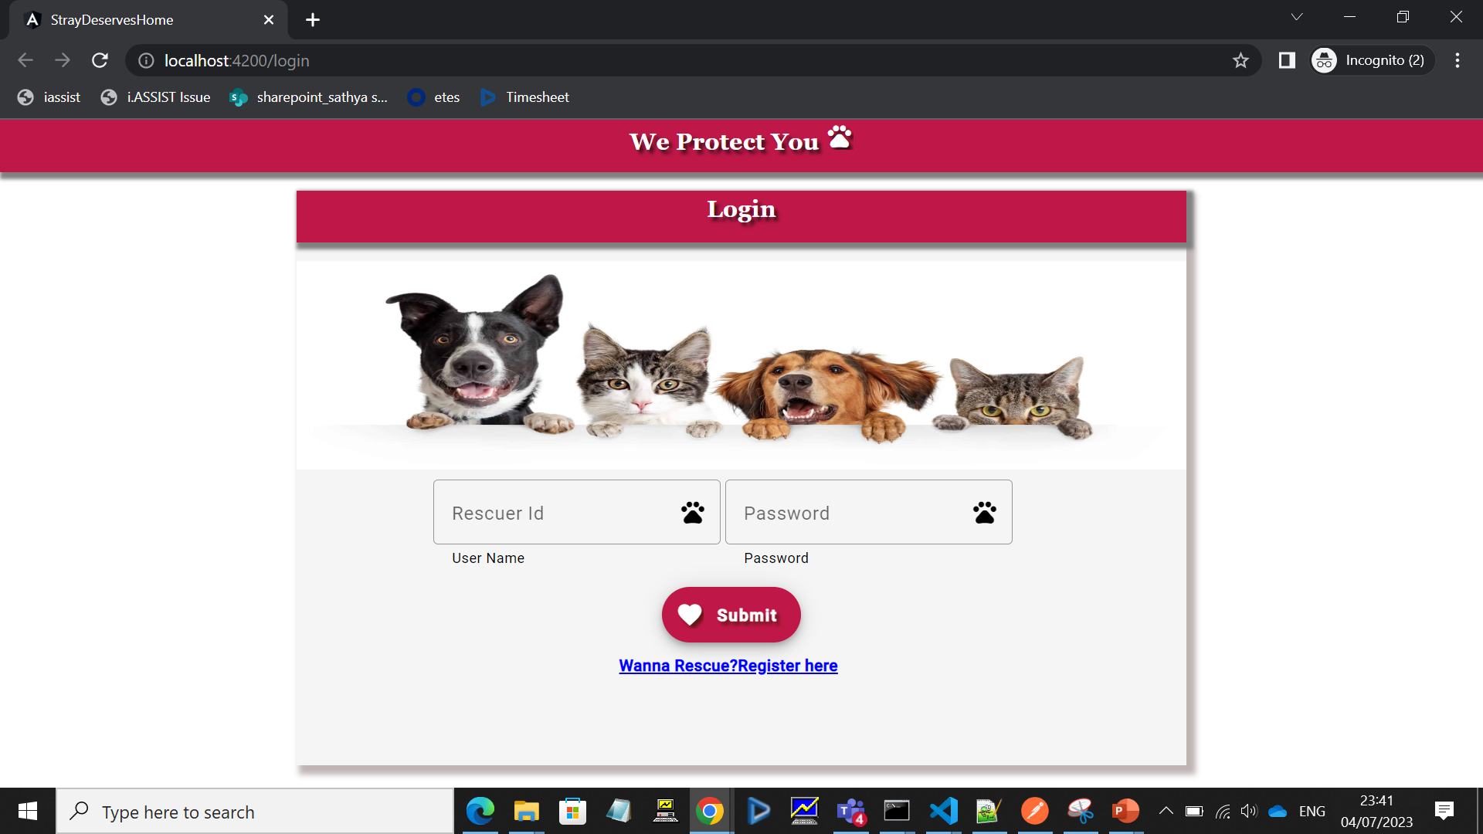
Login Page

Slide 5

Validation

Slide 6
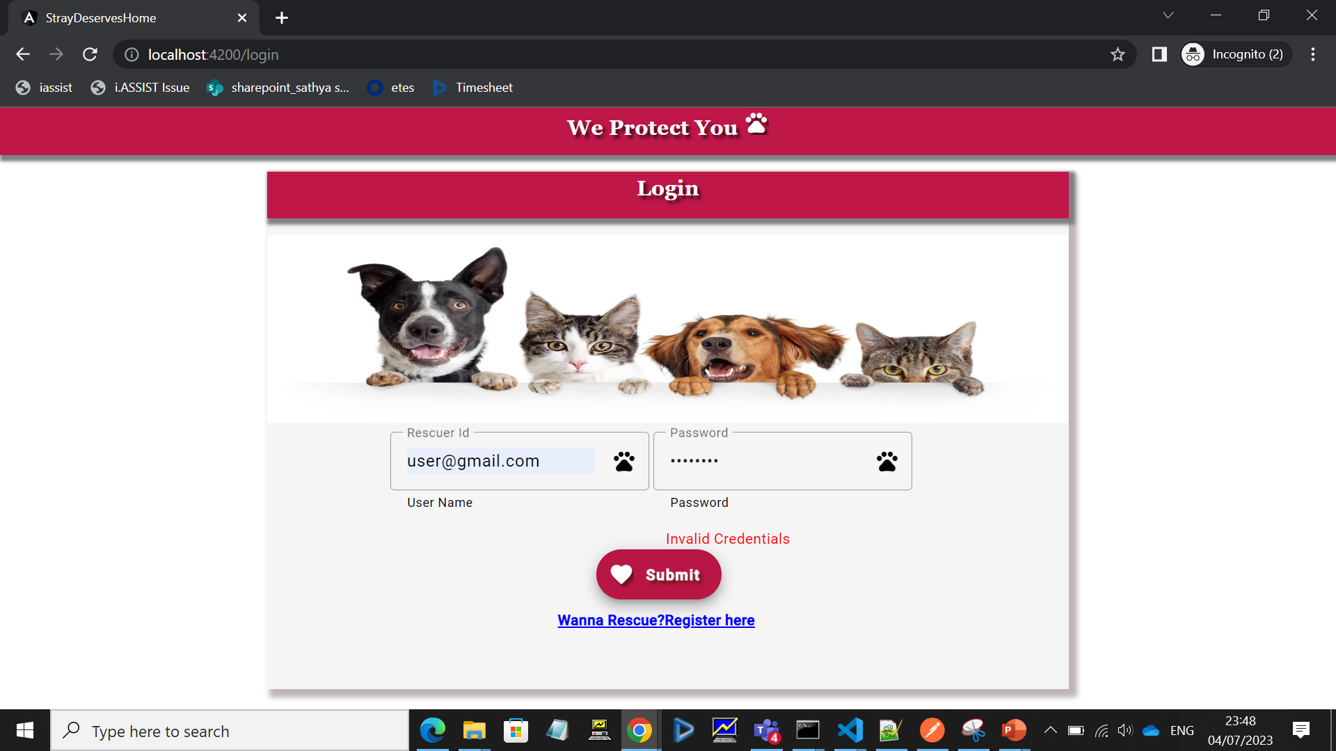
Validation II

Slide 7
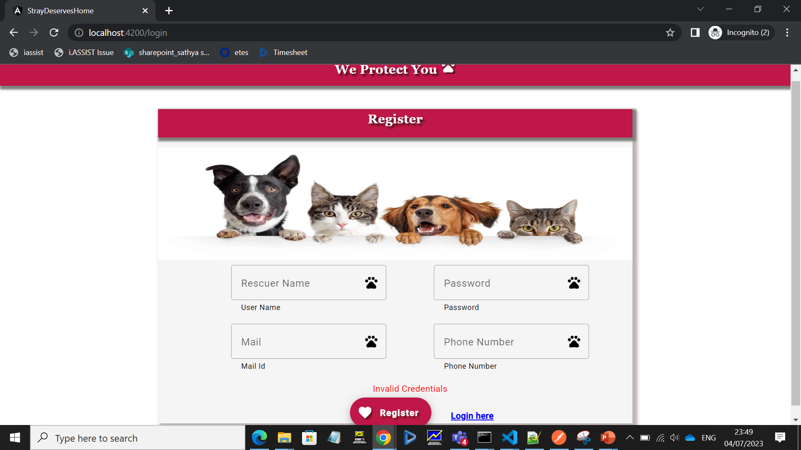
Registration Validation

Slide 8
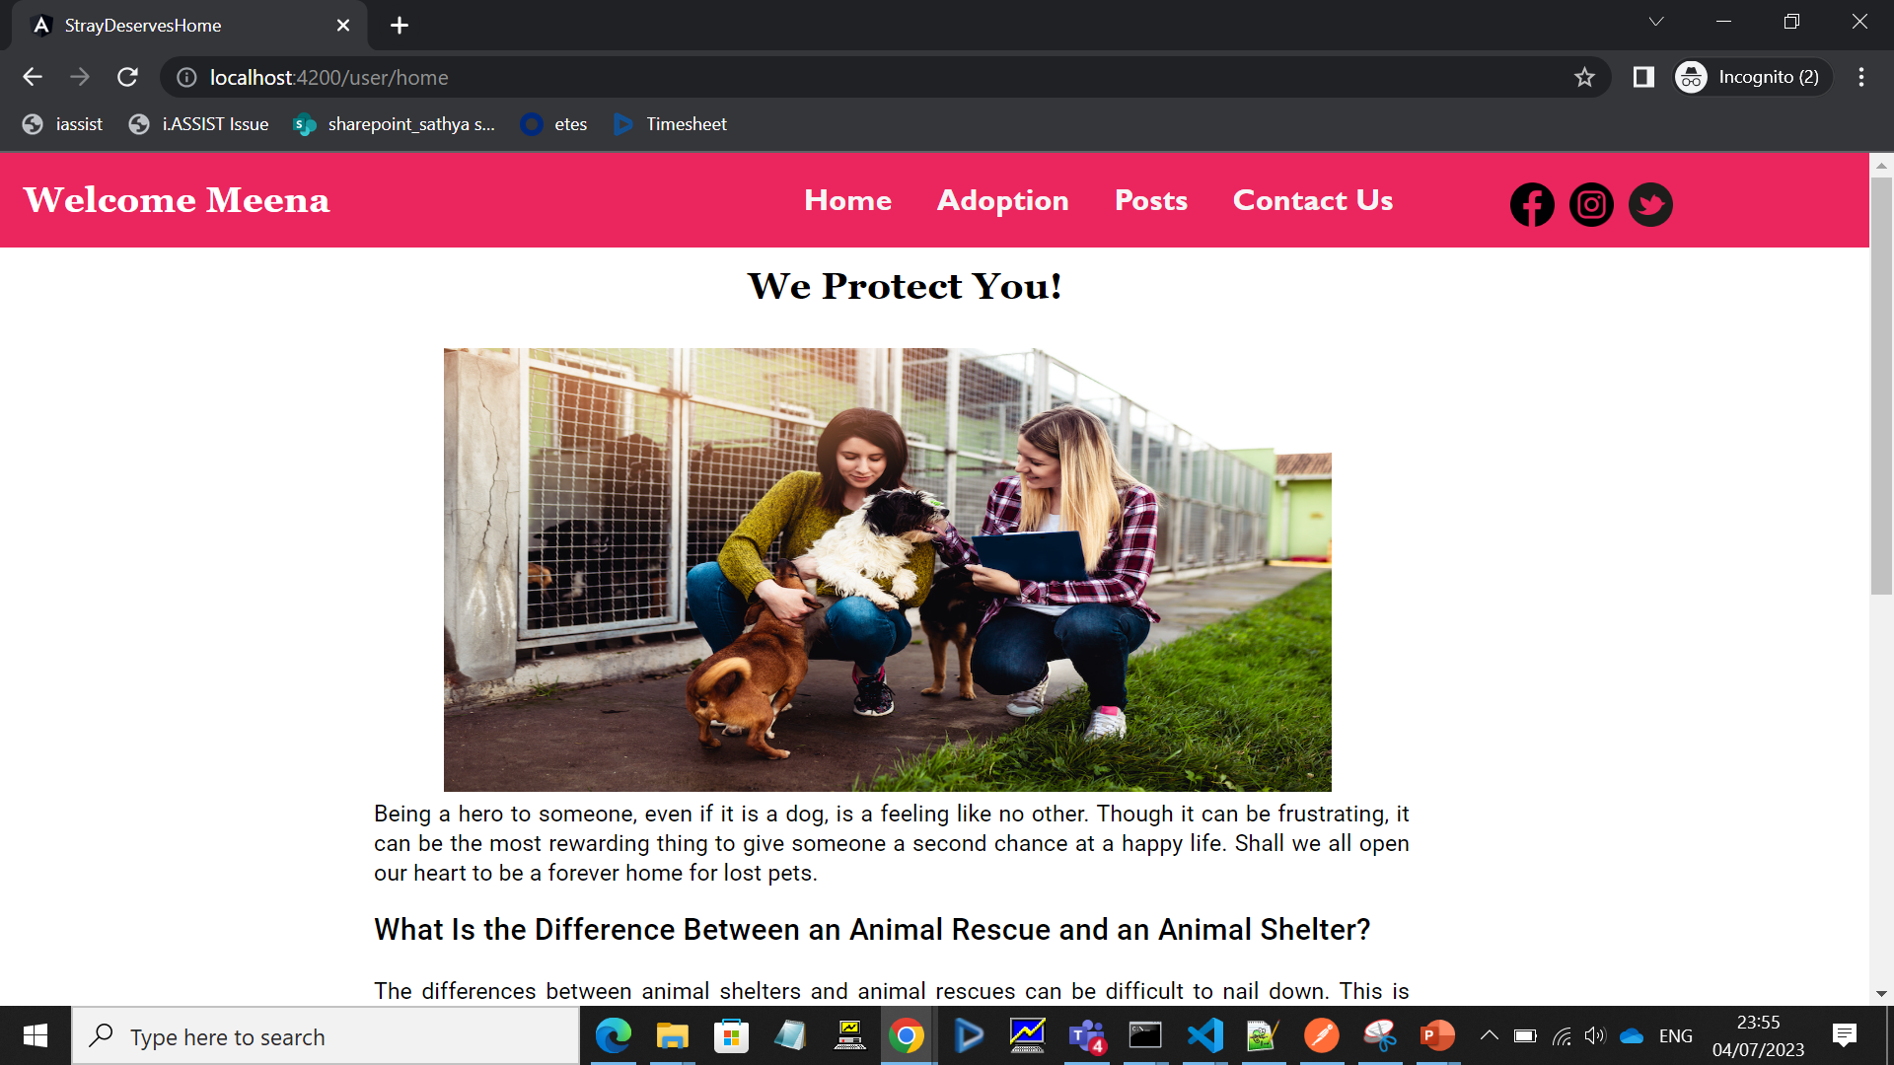
User Home Page

Slide 9
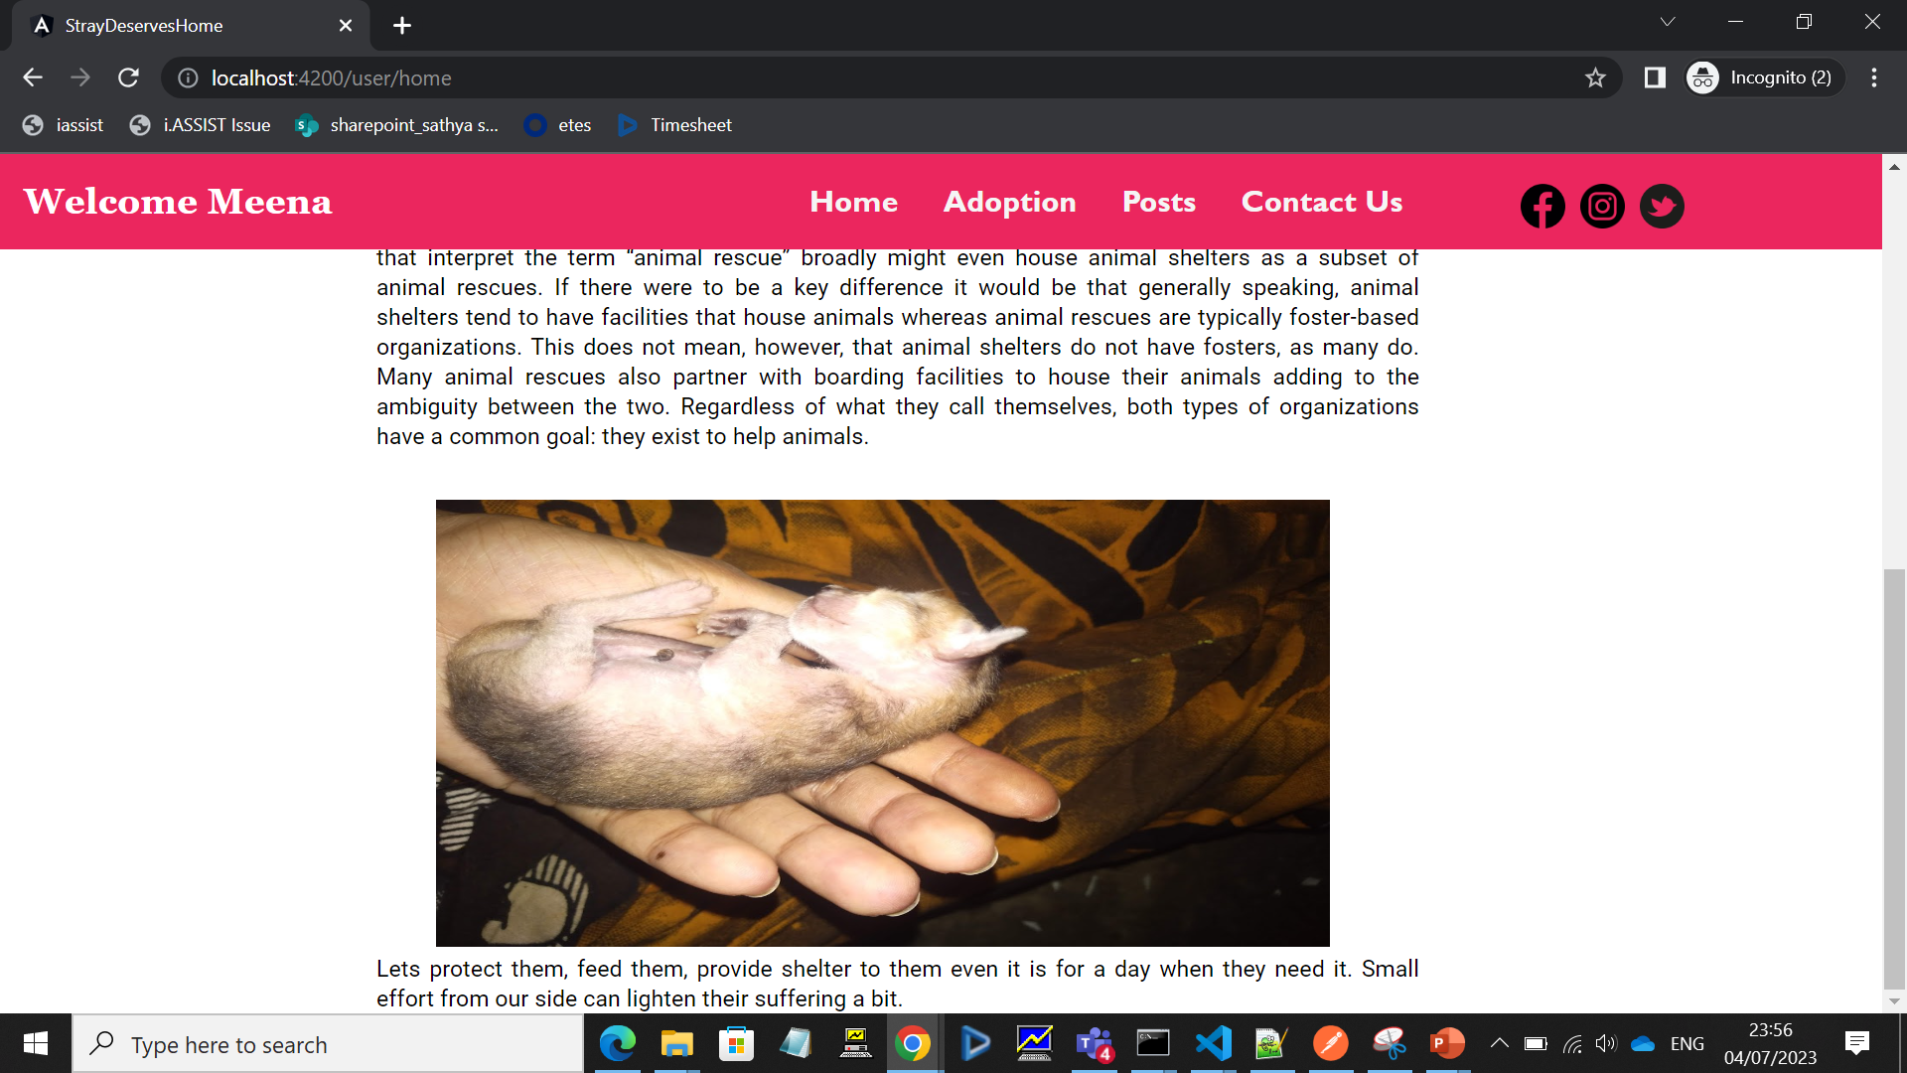
User Home Page II

Slide 10
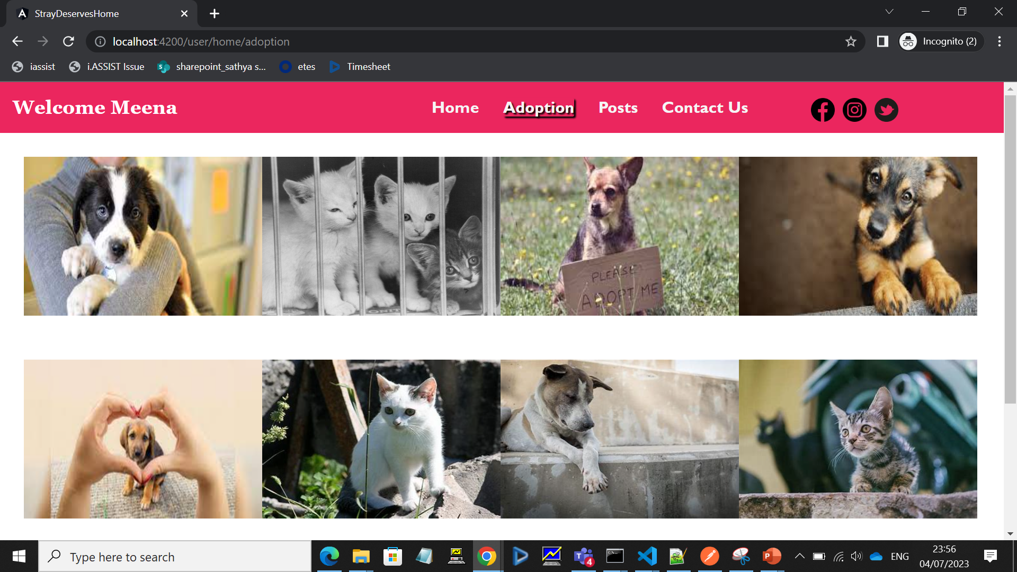
User Adoption I

Slide 11
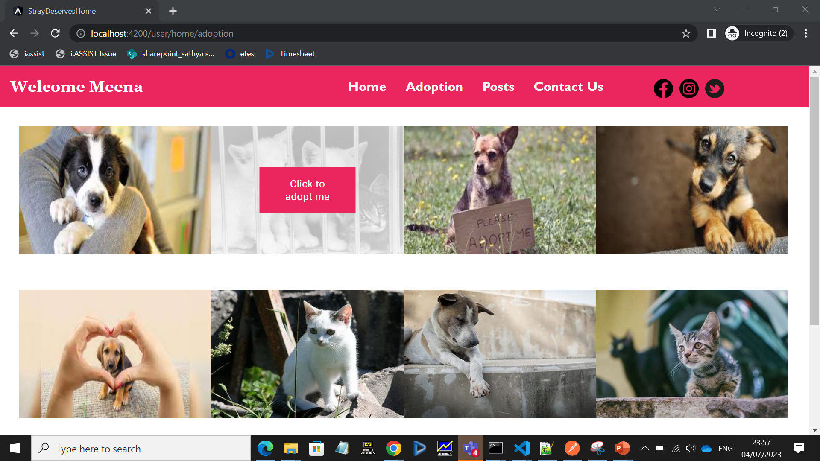
User Adoption II

Slide 12
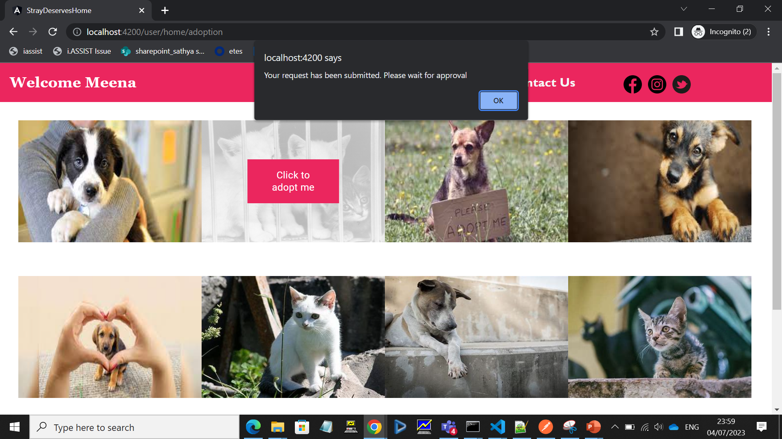
User Adoption III

Slide 13
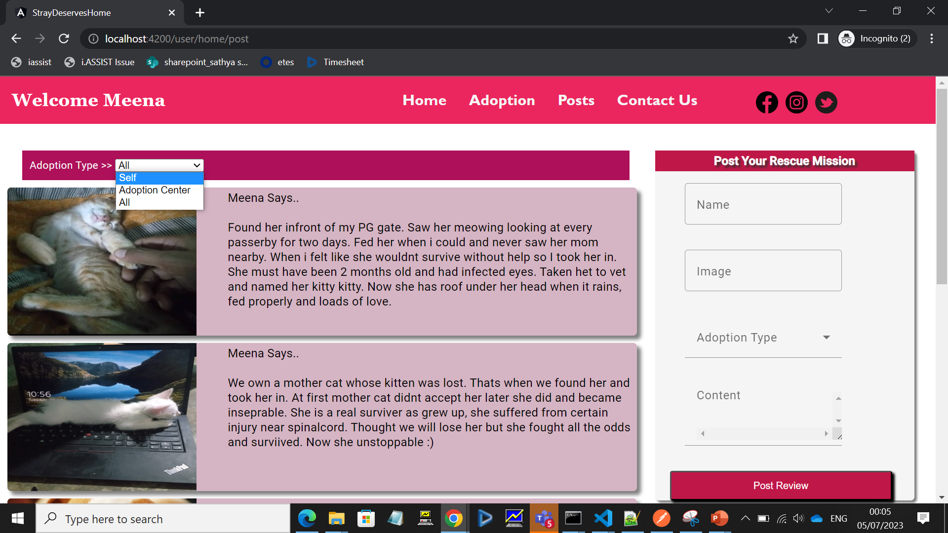
User Post I

Slide 14
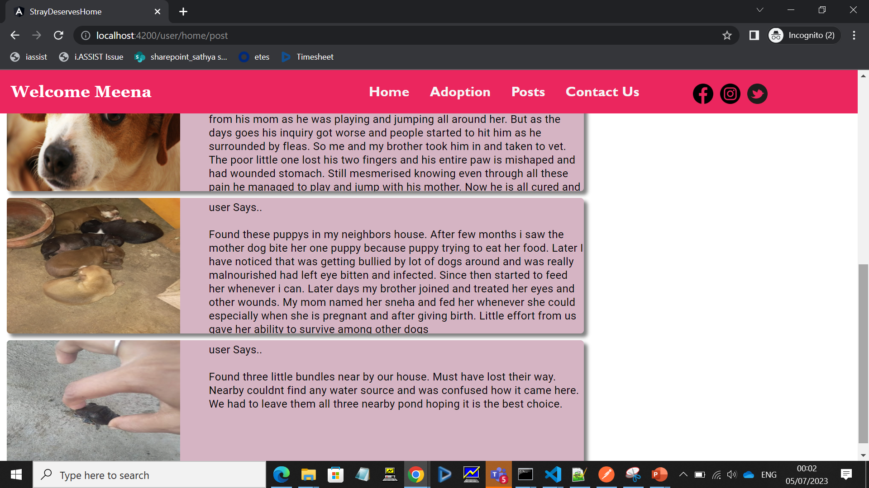
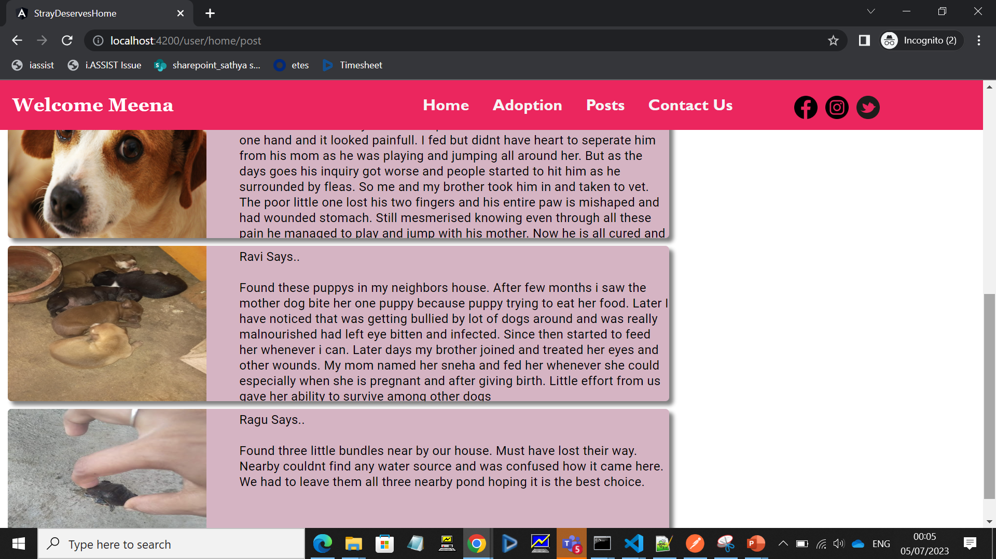
User Post II

Slide 15
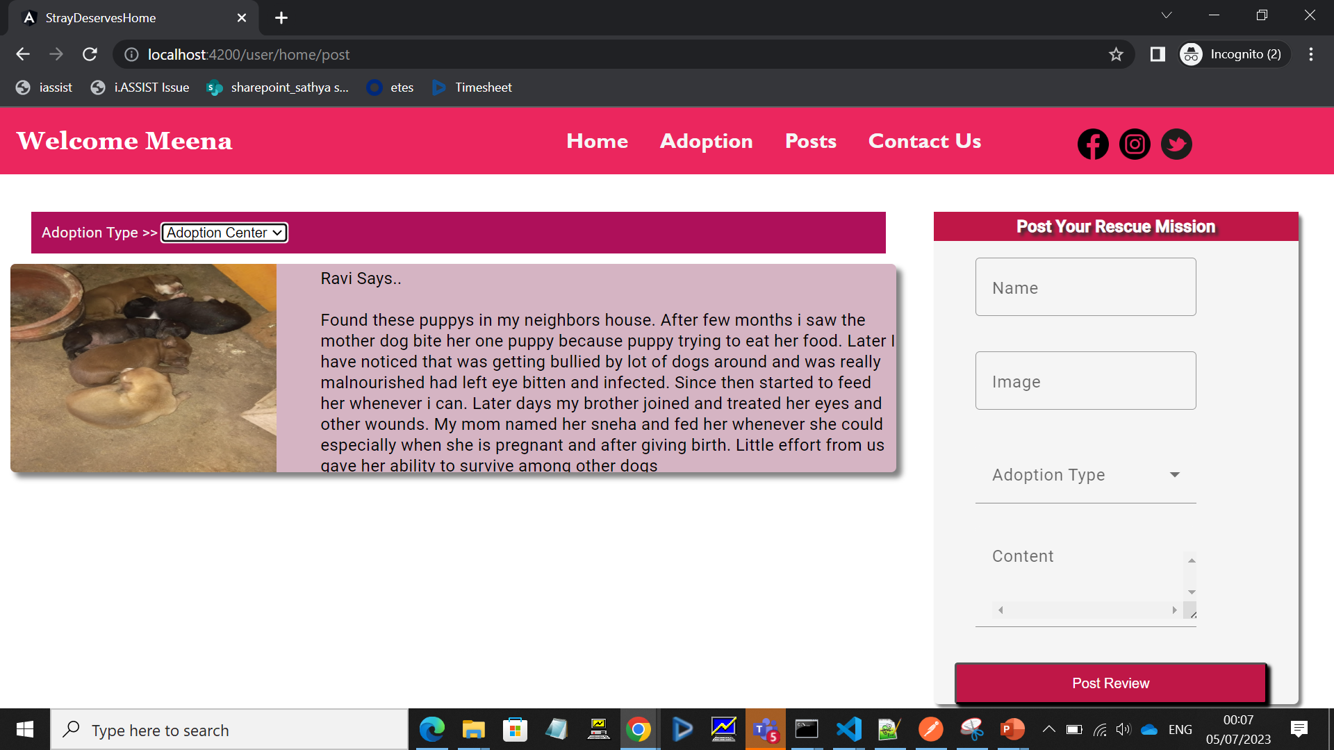
User Post III

Slide 16
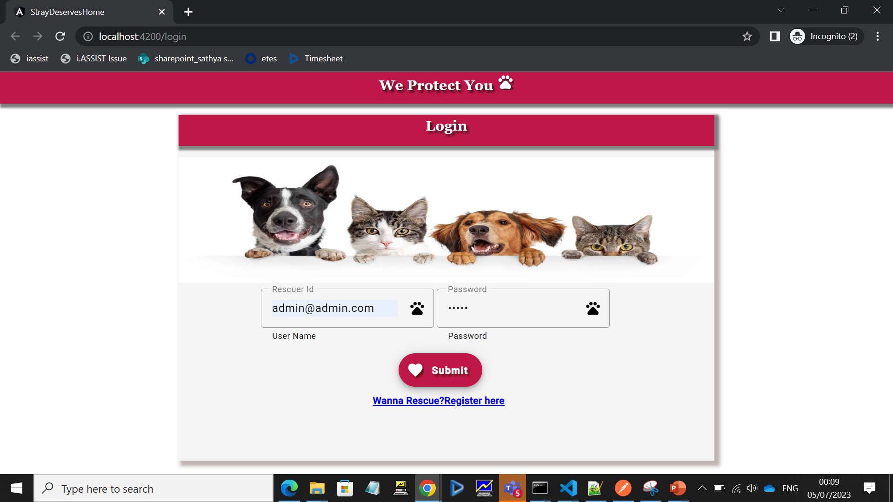
Admin Login

Slide 17
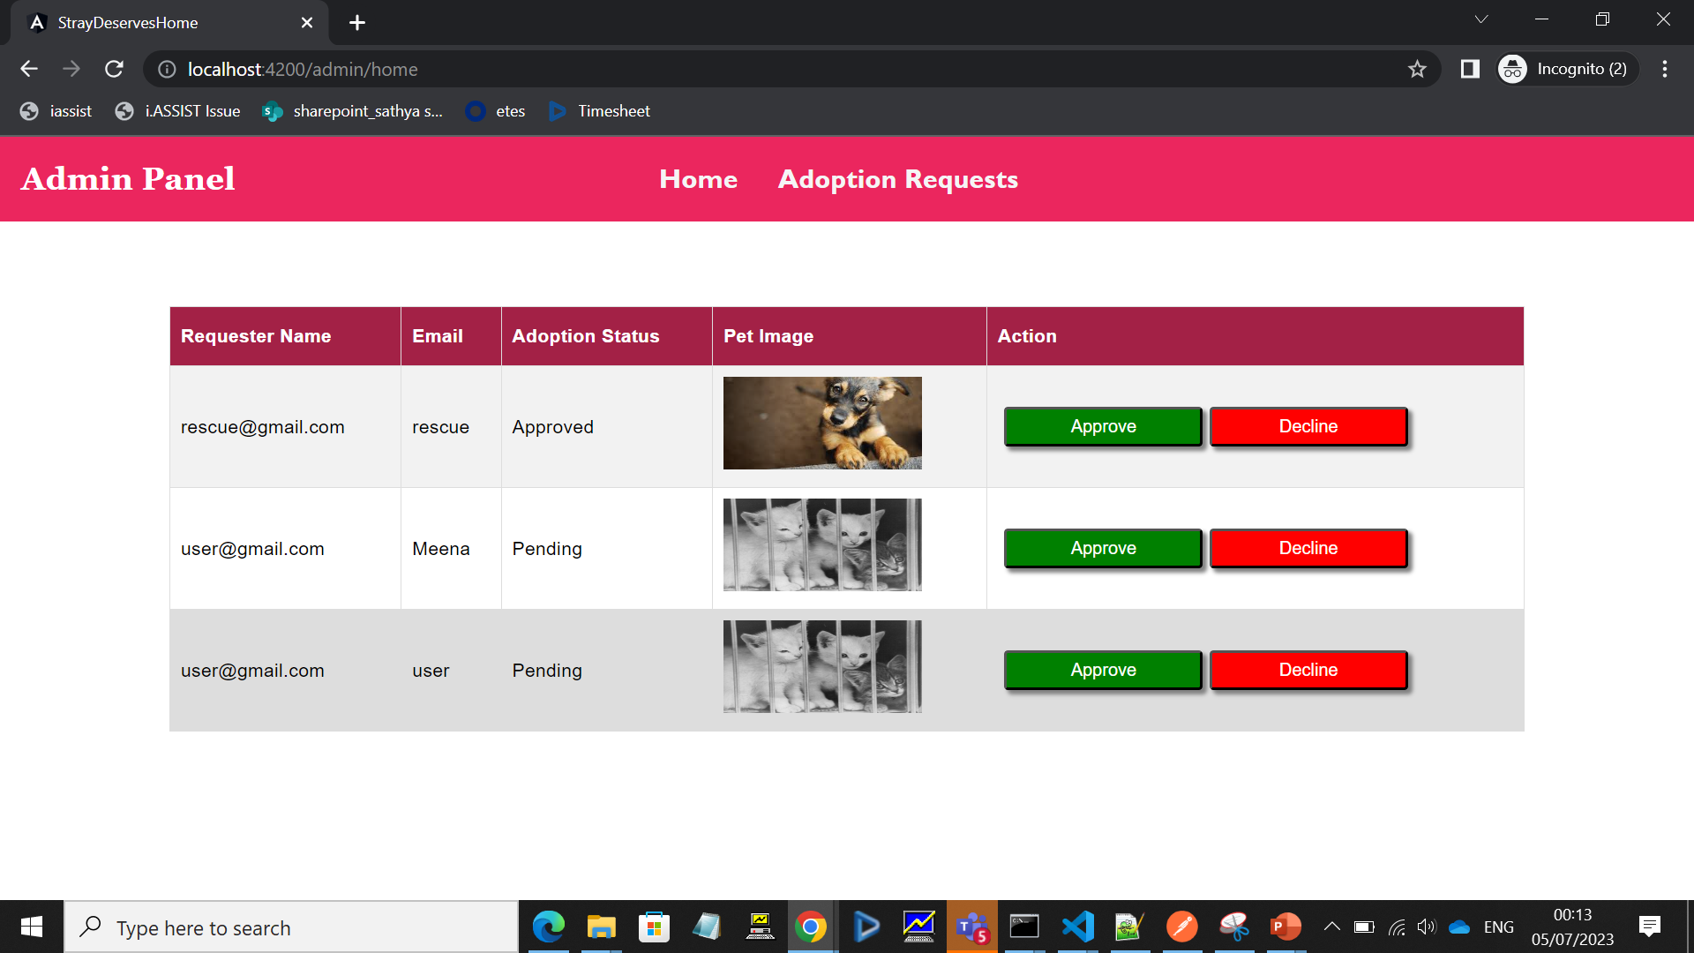
Admin Adoption Requests

Slide 18

Admin Adoption Requests II

Slide 19
Thank You
Meena V
meena.v@dedalus.com

